Slide 1

AI Resume Analyzer Project
_Smart Machine Learning & NLP Tool to Boost Your Career_

Slide 2

Why AI Resume Analyzer?
In today's fiercely competitive job market, a standout resume is crucial. Recruiters increasingly rely on AI tools for initial screening, making optimisation for both artificial intelligence and human eyes absolutely essential. Our innovative AI Resume Analyzer is designed to give candidates a significant edge.
Competitive Job Market
AI Screening Mastery
Ensure your resume captures attention amidst a sea of applications.
Optimise your resume to pass AI filters and reach human recruiters.
Dual Audience Appeal
Craft a resume that impresses both AI algorithms and hiring managers.

Slide 3

What is AI Resume Analyzer?
The AI Resume Analyzer is an intelligent system that harnesses the power of Natural Language Processing (NLP) and Machine Learning (ML) to meticulously read, comprehend, and evaluate resumes.
Resume Upload
NLP Parsing
Keyword Clustering
Personalized Recommendations
It intelligently extracts key information such as skills, experience, and educational background.
Utilising advanced Machine Learning, it clusters keywords to identify relevant job sectors and predict the most suitable job roles.

Slide 4
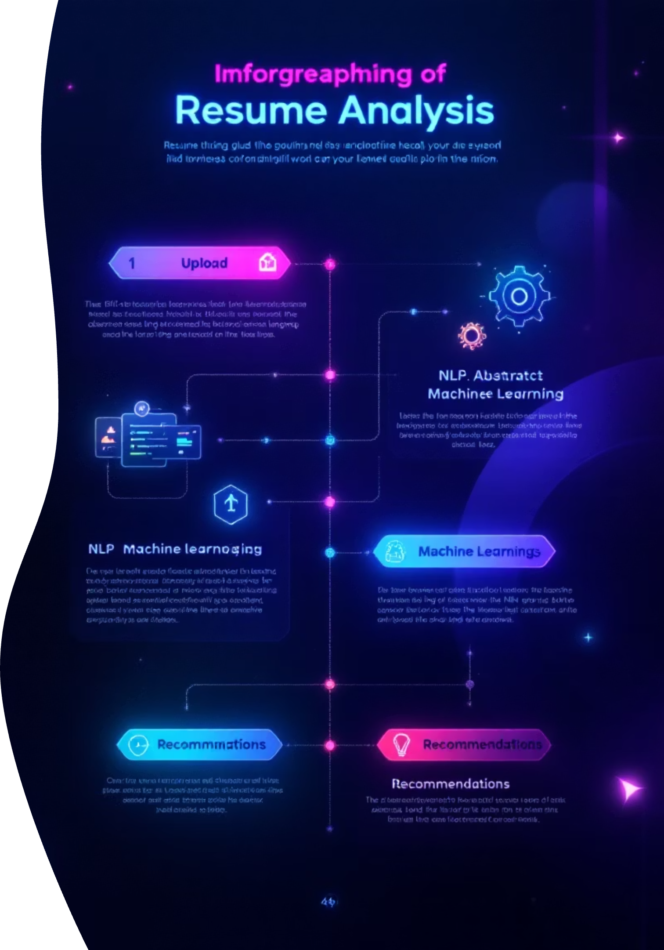
How It Works: Step-by-Step
01
Upload Your Resume
Simply upload your resume in standard formats like PDF or DOC. Our system is designed for ease of use.
02
NLP Data Extraction
Our advanced NLP engine meticulously extracts all relevant data, including skills, education, and work experience.
03
ML Keyword Clustering
Machine Learning algorithms then cluster identified keywords, linking them to various job sectors and industries.
04
Personalised Recommendations
Receive a comprehensive resume score and tailored recommendations to elevate your profile and career prospects.

Slide 5

Key Features
Our AI Resume Analyzer is equipped with powerful features designed to give you a competitive edge in the job market.
Keyword Extraction & Clustering
Resume Scoring
Identifies and groups keywords relevant to various job sectors.
Highlights your strengths and identifies areas for improvement in your resume.
Job Role Prediction
Skill & Course Suggestions
Suggests ideal job roles based on your unique skills and experience.
Recommends relevant skills, courses, and certifications to enhance your profile.

Slide 6

Benefits for Users & Recruiters
For Candidates:
Actionable Feedback: Receive precise recommendations to refine and improve your resume.
Personalised Guidance: Gain AI-driven insights for tailored career growth.
Enhanced Visibility: Optimise your resume to stand out to both AI and human reviewers.
For Recruiters:
Time Efficiency: Automate resume data structuring, saving valuable screening time.
Streamlined Analysis: Easily assess large applicant pools with organised data.
Quality Hires: Quickly identify top talent aligned with specific job requirements.

Slide 7

Real-World Impact & Use Cases
The AI Resume Analyzer offers versatile applications across various stages of career development and recruitment.
Campus Placements
Targeted Job Applications
Empowers students to craft compelling resumes for their first career steps.
Helps job seekers tailor their resumes precisely for specific roles, increasing success rates.
HR Data Analysis
Continuous Learning
Enables HR teams to efficiently analyse vast amounts of applicant data, improving decision-making.
Supports professional growth with intelligent course and certification recommendations.

Slide 8





Creative Ideas & Future Enhancements
We are constantly innovating to bring even more value to your career journey.
AI Chatbot & Interview Tips
Integrated AI chatbot for instant career advice and personalised interview preparation strategies.
Video Resume Analysis
Future-proofing with analysis of video resumes, including body language and communication style feedback.
Multi-Language Support
Expanding our reach with support for multiple languages, including Hindi and various regional Indian languages.
Dedicated Mobile App
A convenient mobile application for on-the-go resume analysis and career insights, anytime, anywhere.

Slide 9

Conclusion: Empower Your Career with AI
The AI Resume Analyzer isn't just a tool; it's your strategic partner in navigating the complexities of the modern job market.
Bridging the Gap: Seamlessly connects ambitious candidates with discerning recruiters.
Unlocking Opportunities: Harnesses cutting-edge ML & NLP to reveal new career pathways.
Transform Your Journey: Take the first step towards a brighter professional future today!

Slide 10

Thank you!
Git hub:taranginidave/AI_RESUME_ANALYZER: AI Resume Analyzer evaluates resumes using NLP and machine learning to match skills with job descriptions, give a match score, highlight missing keywords, and provide improvement suggestions. It helps job seekers optimize resumes and assists recruiters in fast, accurate screening.

